Slide 1


ADAPTIVE INTELLIGENT CONTROL OF AIR CONDITIONING SYSTEM WITH HOME AUTOMATION
PRESENTEED BY,
POOJITH HS (1DS20EE048)
PUNITH KUMAR (1DS20EE051)
RAKSHIT MOKTALI(1DSEE054)
SRUJAN KASHYAP(1DS20EE072)

Slide 2

Table of contents
01
02
03
05
Introduction
Components required
Working
Evolution of Components
06
07
Diagrams
Applications

Slide 3

Introduction
The residential sector accounts for around 24% of the total electricity consumption in India. Recent studies show that air conditioners (ACs) have become a significant contributor to residential electricity consumption.
It is predicted that by 2037, the demand for ACs will increase by four times due to their affordability and availability. Results showed that AC alone contributed to 39% of the total household consumption in summers.
This project aims to develop an automatic AC temperature control system based on ambient temperature using home automation.
The proposed system uses a microcontroller- based circuit to collect ambient temperature data from a sensor and adjust the AC temperature settings accordingly.
The proposed project offers an affordable and convenient way to regulate indoor temperatures by minimizing energy consumption.

Slide 4


Components Required
1.ESP module
2.Relay module
3.OLED screen
4.Hi-Link converter
5.DHT22 sensor
6. TSOP1838
7.IR LED
8.Connecting wires
9.Perf board

Slide 5
Evolution of components:
2018
2023
DHT11–Temperature and Humidity Sensor:
Ultra low cost
3 to 5V power and I/O
Good for 20-80% humidity readings with 5% accuracy
Good for 0-50°C temperature readings ±2°C accuracy
No more than 1 Hz sampling rate (once every second)
Body size 15.5mm x 12mm x 5.5mm
4 pins with 0.1" spacing
DHT22–Temperature and Humidity Sensor:
Low cost
3 to 5V power and I/O
Good for 0-100% humidity readings with 2-5% accuracy
Good for -40 to 80°C temperature readings ±0.5°C accuracy
No more than 0.5 Hz sampling rate (once every 2 seconds)
Body size 15.1mm x 25mm x 7.7mm
4 pins with 0.1" spacing
TSOP-1738 IR reciver:
Operating voltage: -0.3 and 5V
Carrier Frequency: 38kHz
Operating current: 5mA
Will respond only to IR signals, due to high immunity against ambient light
Low power consumption
Has in-built pre amplifier
TTL and CMOS compatible
TSOP-1838 IR reciver:
Operating Voltage: 2.5V to 5.5V
Carrier Frequency : 38kHz
Operating current: 5mA
High Range and wide coverage area.
Improved immunity against HF and RF noise
Has in-built pre amplifier
TTL and CMOS compatible

Slide 6
Working Of The Module Responsible For AC Control
Adaptive Temperature Control Circuit that can minimize the electricity charges by varying the AC temperature automatically based on the Rooms temperature. By varying the temperature periodically we can avoid the working of AC for long hours on heavy load thus making it consume less power.
To automate this process this project uses a Temperature sensor (DHT 22) which reads the present temperature of the room and based on that value it will send commands to the AC through an IR blaster similar to the AC’s Remote. The AC will react to these commands as if it is reacting to its Remote and thus adjust the temperature accordingly.
A TSOP8738 is an IR Receiver that could be used to decode the signal coming from the Remotes. This Receiver will be interfaced with ESP32 to signal for each button and then an IR Led will be used with ESP32 to mimic the signal when ever required. This way we can gain control over our AC using ESP32.

Slide 7

Working Of Home Automation
For sending the command and receiving the command the ESP module which will be connected to a mobile and it will communicate with the microcontroller to control the connected relay.
If a certain command is sent to the microcontroller ;for ex: if ‘A’ is sent the relay will be turned on and if ‘a’ is sent the relay will be turned off. This command is sent through WIFI which will be received by ESP and accordingly the actions will take place.
A DHT 22 temperature and humidity sensor is also added which will measure the temperature and humidity.
If the temperature rises above a certain level, one of the switches in relay module will be automatically turned on to which a fan can be connected so that the temperature is reduced automatically.
The measured temperature will be displayed on a OLED screen which is Interfaced with the Microcontroller(ESP).

Slide 8
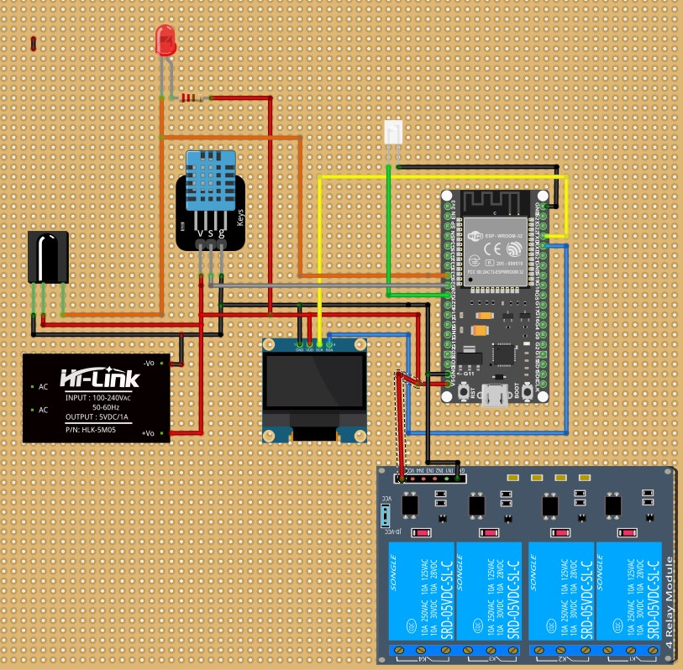
Circuit Diagram

Slide 9
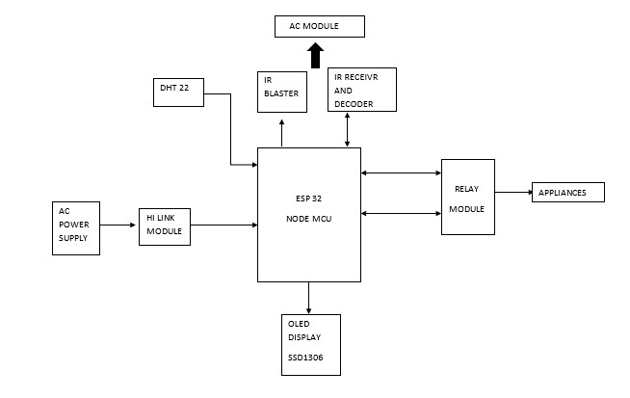
Block Diagram

Slide 10

Applications
Home
Mall
Shopping complex
Hospitals
Factories
School & College
In temperature controlled testing laboratories
Automatic temperature and humidity control system using air-conditioning in transformer substation.

Slide 11

References
[1] Fontes, F.; Antão, R.; Mota, A.; Pedreiras, P. Improving the Ambient Temperature Control Performance in Smart Homes and Buildings. Sensors 2021, 21, 423. https://doi.org/10.3390/s21020423
[2] Smart Sensors Enable Smart Air Conditioning Control Chin-Chi Cheng and Dasheng Lee *Department of Energy and Refrigerating Air- Conditioning Engineering, National Taipei University of Technology, Taipei 10608,Taiwan; E-Mail: newmanch@ntut.edu.tw doi:10.3390/s140611179
[3] F. Budiman, M. Rivai, I. G. Bagus Prasta Raditya, D. Krisrenanto and I. Z. Amiroh, "Smart Control of Air Conditioning System Based on Number and Activity Level of Persons," 2018 International Seminar on Intelligent Technology and Its Applications (ISITIA), Bali, Indonesia, 2018, pp. 431-436, doi:10.1109/ISITIA.2018.8711311.
[4] L. Feng, Z. Hui and T. Yan, "Automatic Temperature and Humidity Control System Using Air-Conditioning in Transformer Substation," 2012 Asia-Pacific Power and Energy Engineering Conference, Shanghai, China, 2012, pp. 1-4, doi: 10.1109/APPEEC.2012.6306942.
[5] Elkholy, M.H.; Senjyu, T.; Lotfy, M.E.; Elgarhy, A.; Ali, N.S.; Gaafar, T.S. Design and Implementation of a Real-Time Smart Home Management System Considering Energy Saving. Sustainability 2022, 14, 13840. https://doi.org/10.3390/ su142113840
[6] Philip, A.; Islam, S.N.; Phillips, N.; Anwar, A. Optimum Energy Management for Air Conditioners in IoT-Enabled Smart Home. Sensors 2022, 22, 7102. https://doi.org/10.3390/ s22197102
[7] Ramapragada, P., Tejaswini, D., Garg, V., Mathur, J., & Gupta, R. (2022). Investigation on air conditioning load patterns and electricity consumption of typical residential buildings in tropical wet and dry climate in India. Energy Informatics, 5(4), 1-20. https://doi.org/10.1186/s42162-022-00228-1

Slide 12
Thank You

